Slide 2
Russian Ophthalmology Society
Founded in 1885

Slide 3
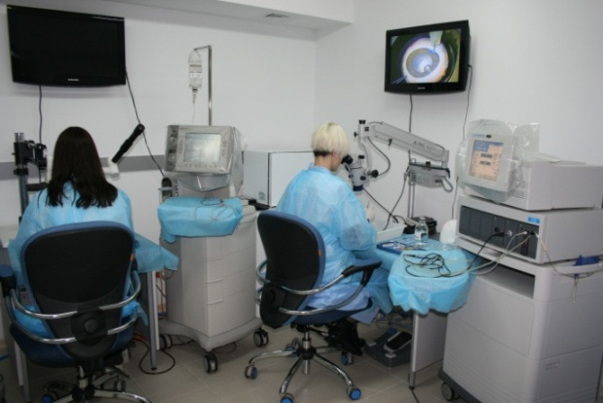
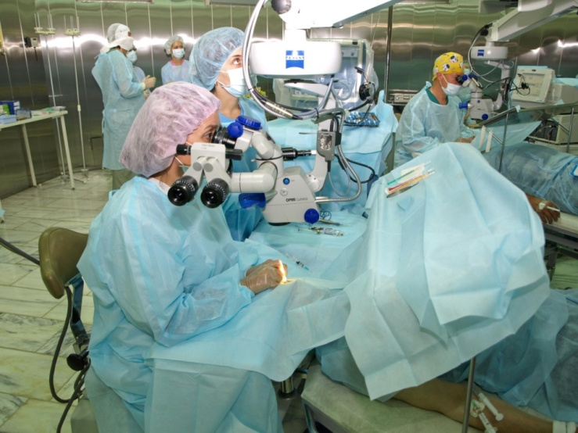
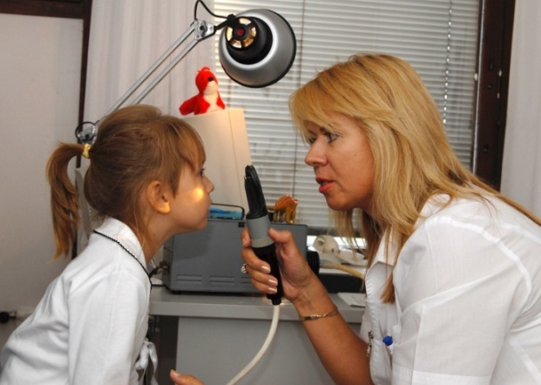
Russian Ophthalmology Society
Major Goals
Development of Ophthalmology in Russian Federation
Creation of environment for continuous professional growth of its members
Protection ROS members rights and legal
Strengthening the links between science and practice

Slide 4
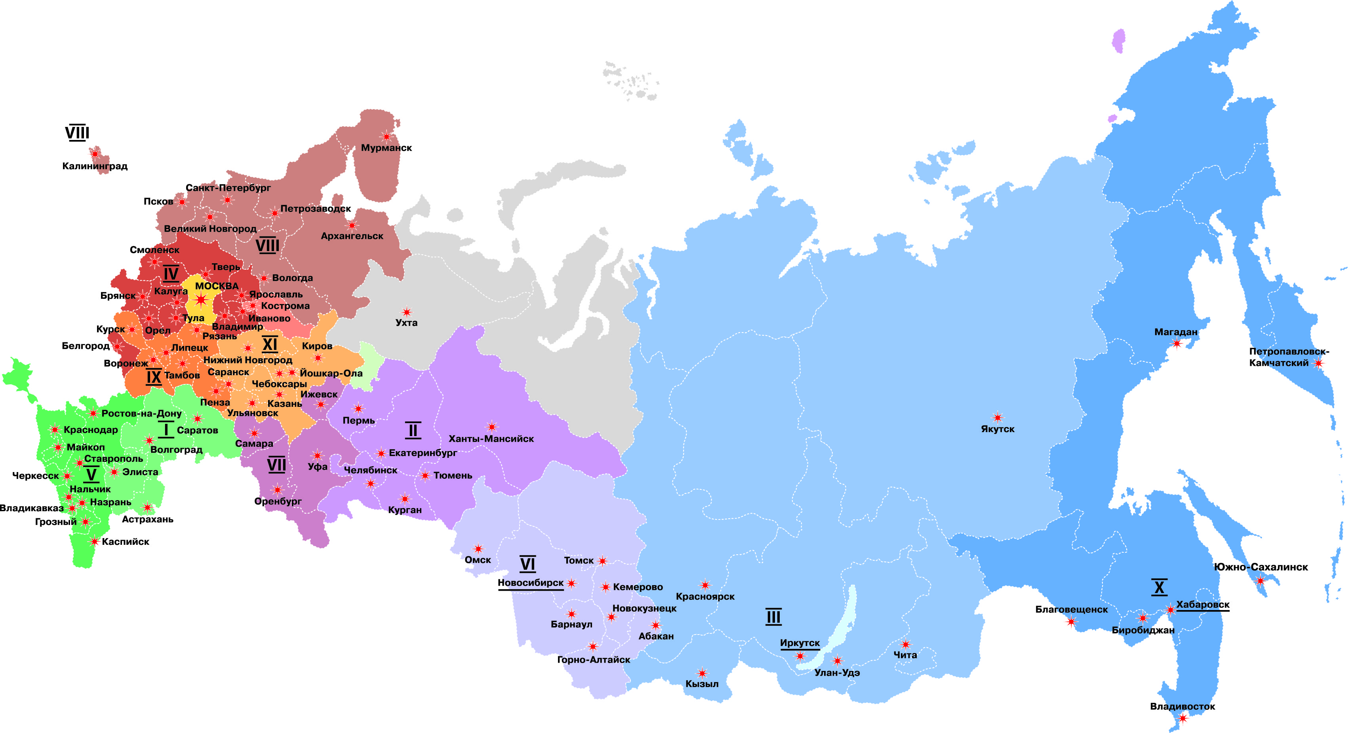
Russian Ophthalmology Society
ROS includes 80 regional divisions and more than 8000 members

Slide 5
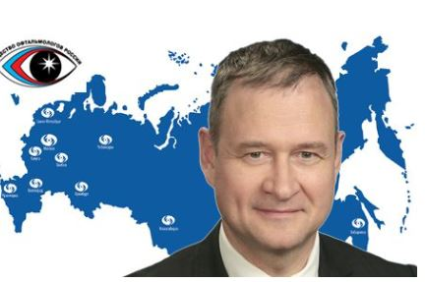
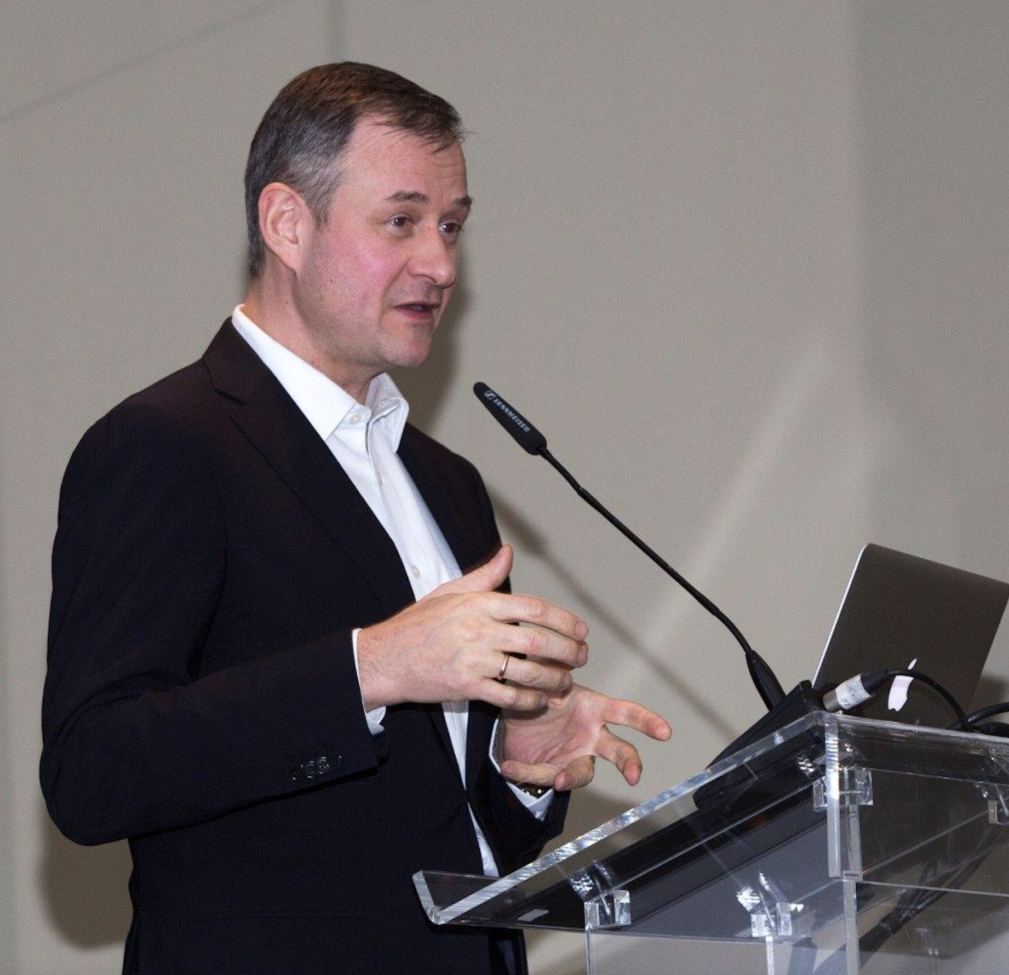
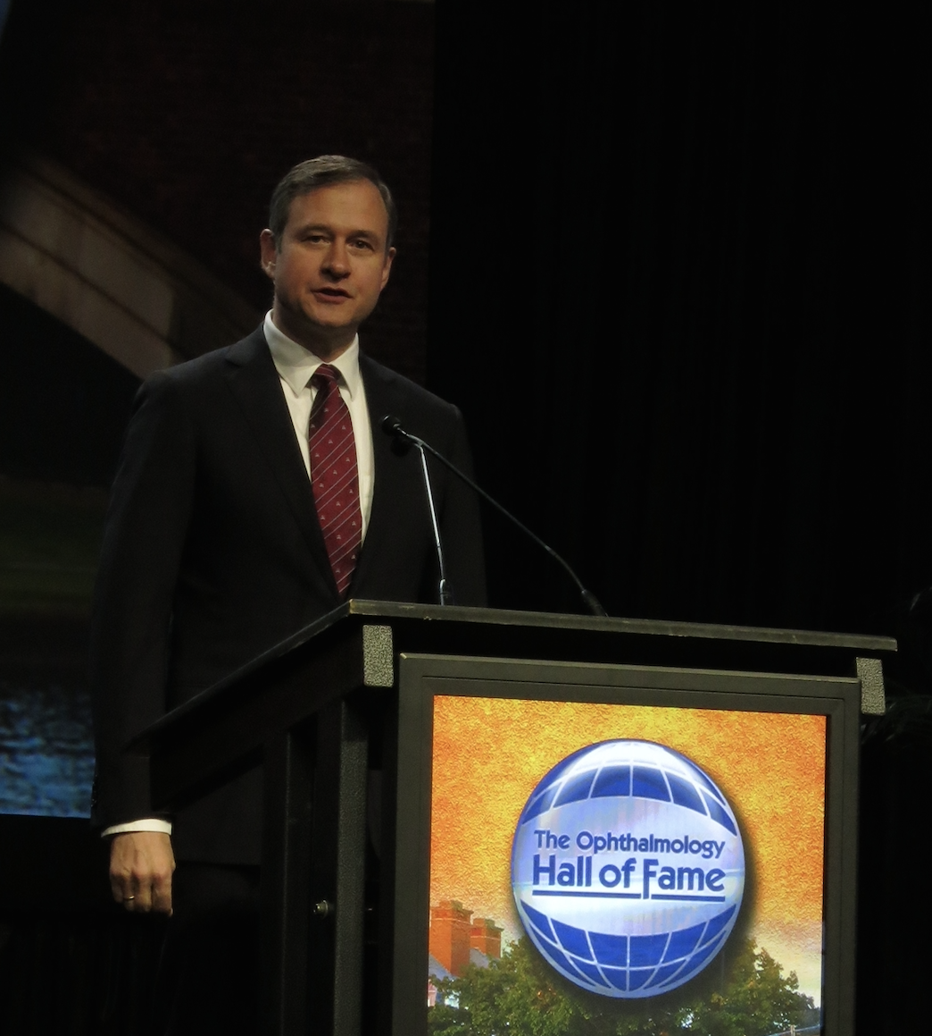
Russian Ophthalmology Society
Dr. Boris Malyugin
Russian Ophthalmology Society President
Professor of Ophthalmology,
Deputy Director General (R&D, Edu) at the S. Fyodorov Eye Microsurgery State Institution, Moscow, Russian Federation
https://drborismalyugin.com

Slide 6
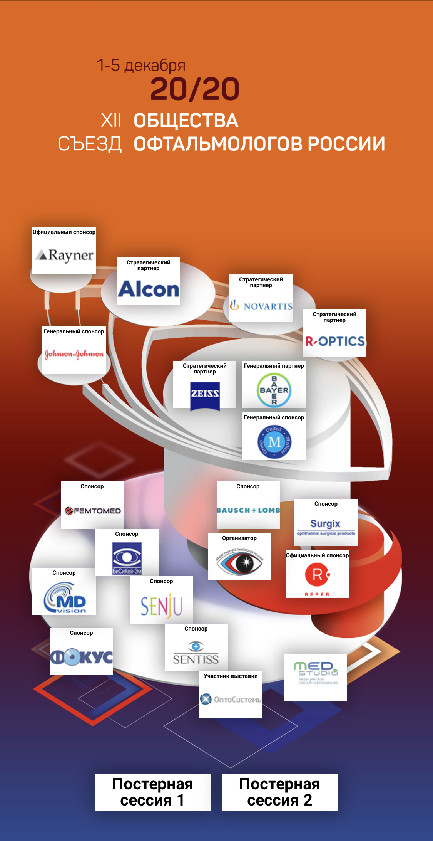
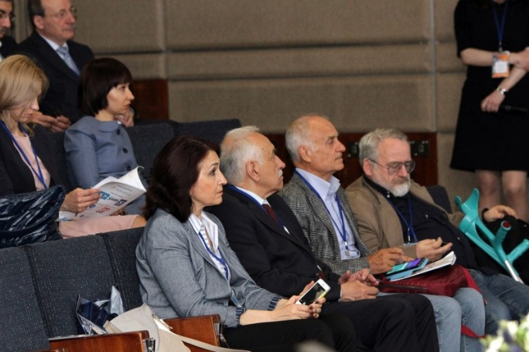
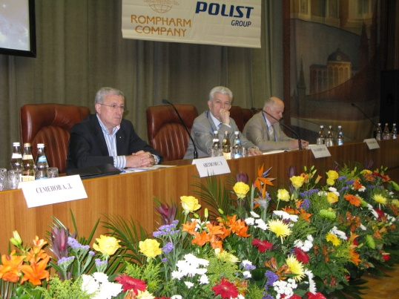
Russian Ophthalmology Society
Russian Ophthalmology Society meeting is the biggest ophthalmic event in Russia. Usually it attracts from 1500 to 2000 attendees. In 2020 more than 6400 ophthalmologist were participating in this event made online first time in the history of ROS.

Slide 7
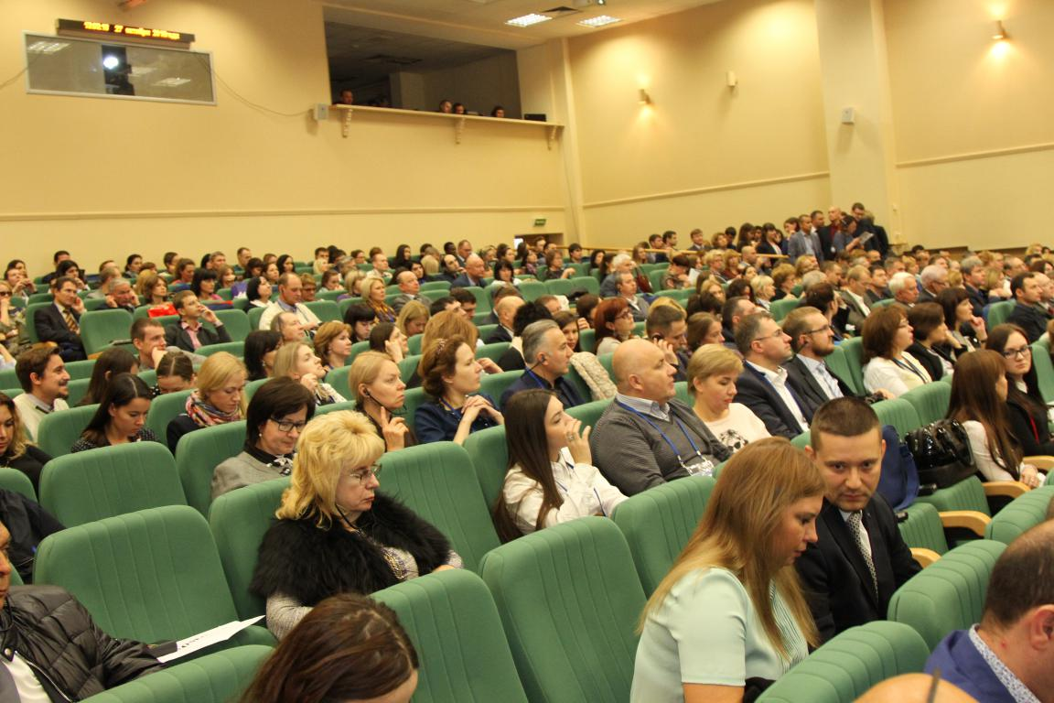
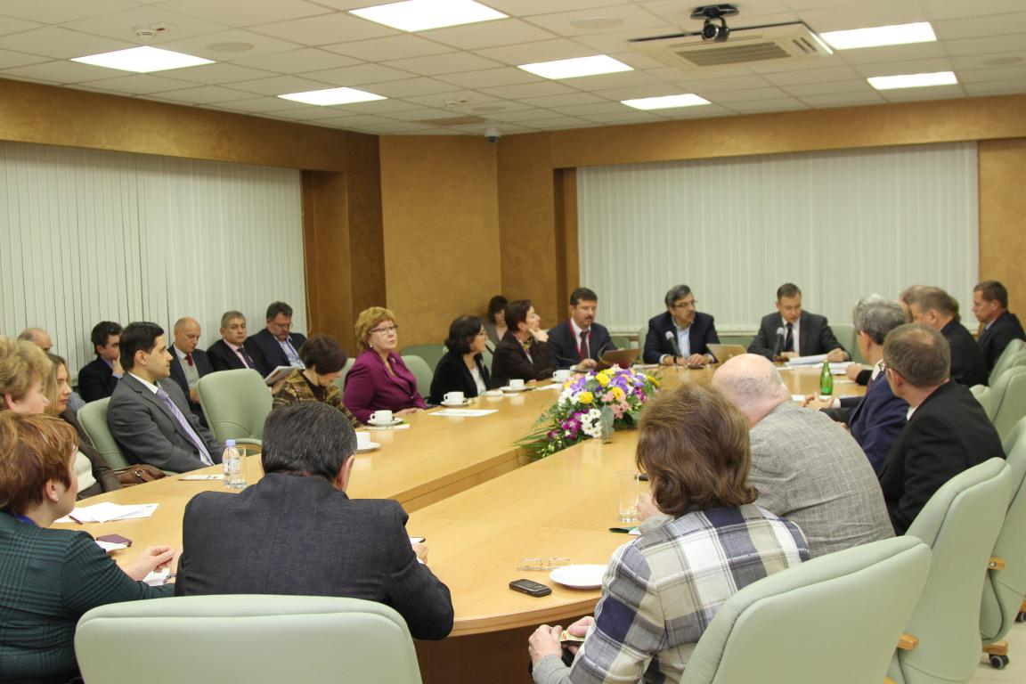
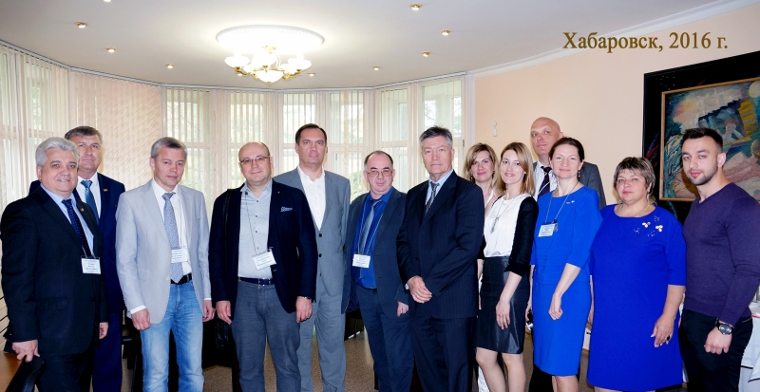
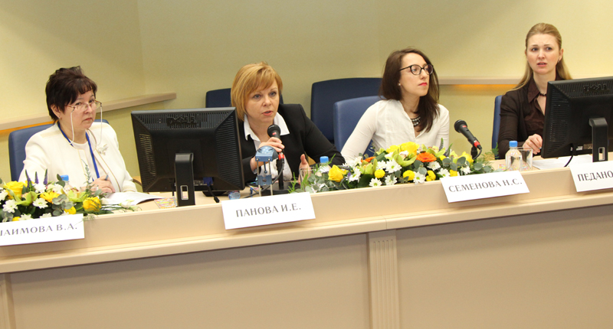
Russian Ophthalmology Society
More than 40 regional meetings are organized annually under the aegis of the ROS.

Slide 8
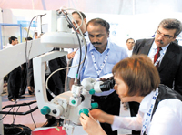
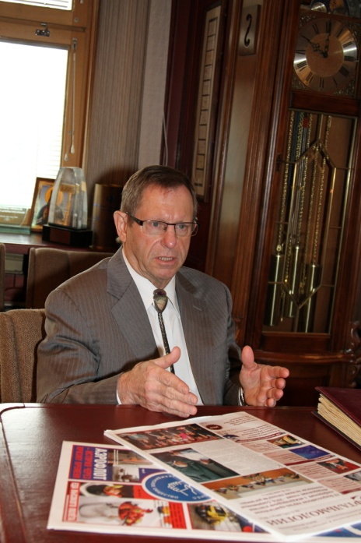
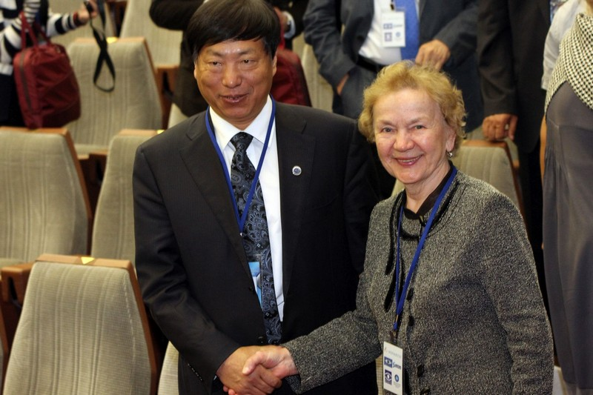
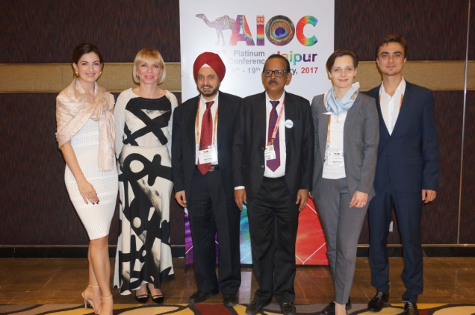
Russian Ophthalmology Society
ROS is a Full Member of the International Council of Ophthalmology (ICO). It has close relationship with many national societies (Chinese, All India, Israeli, Brazilian, etc).

Slide 9
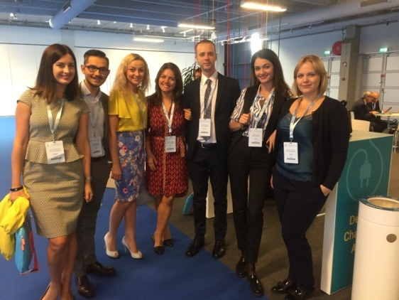
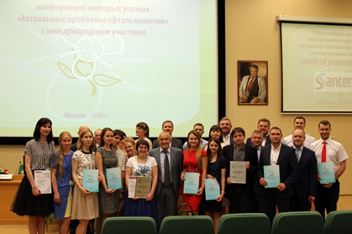
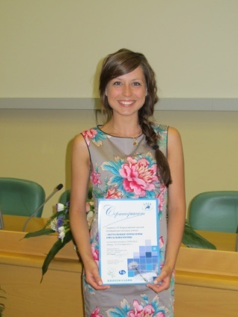
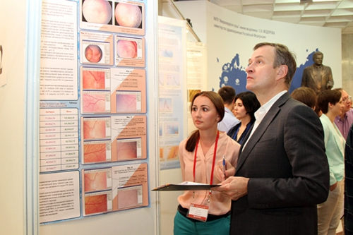
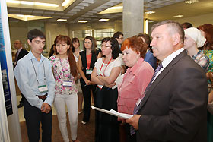
Russian Ophthalmology Society
Young Ophthalmologist meeting is organized
by the ROS annually

Slide 10
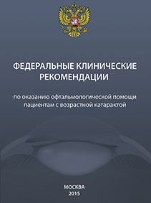
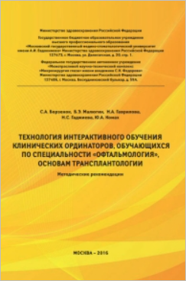
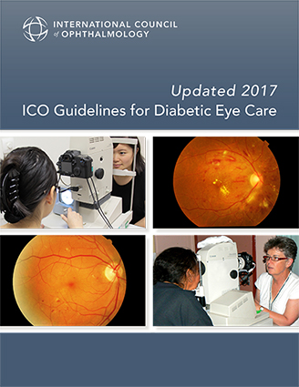
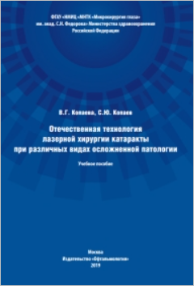
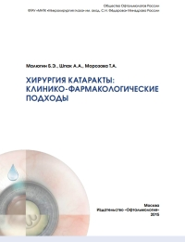
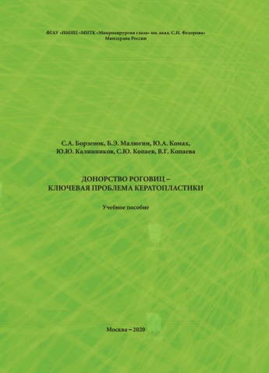
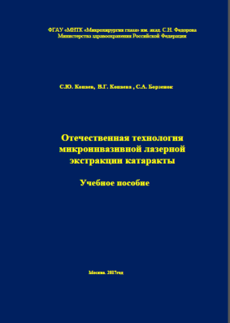
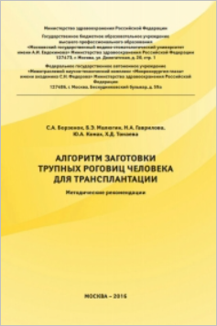
Russian Ophthalmology Society
ROS participates in the development and implementation of professional standards, the clinical guidelines, etc.

Slide 11
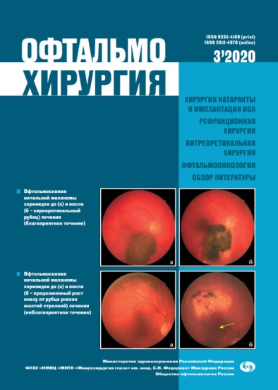
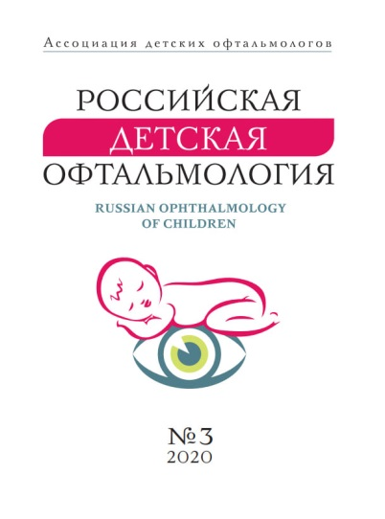
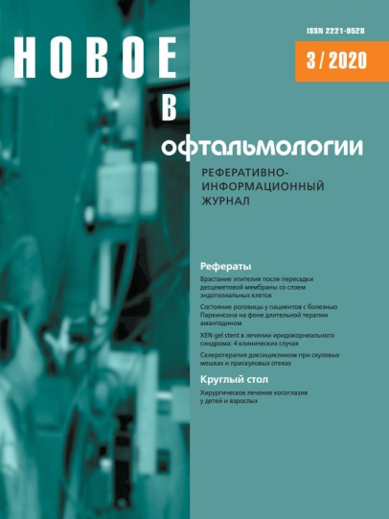
Russian Ophthalmology Society
ROS is publishing various scientific journals in the area of Ophthalmology and Visual Sciences

Slide 12
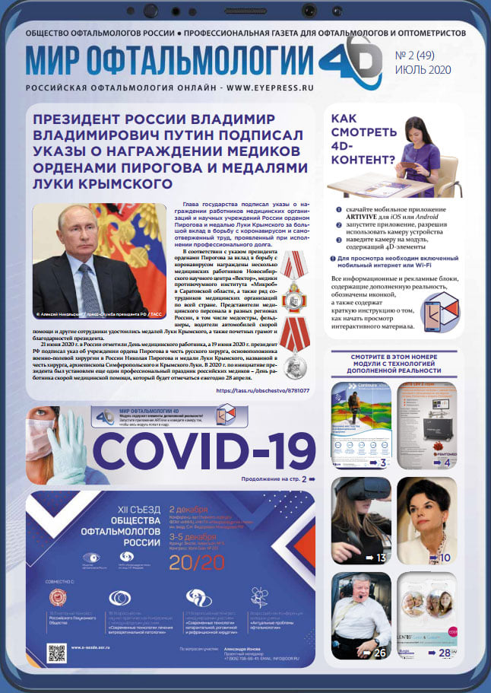
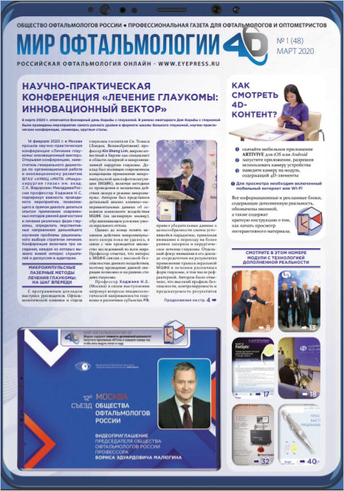
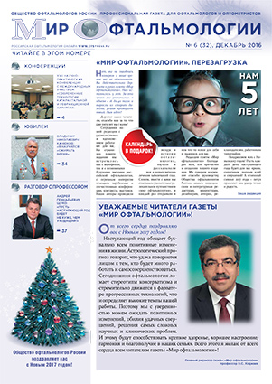
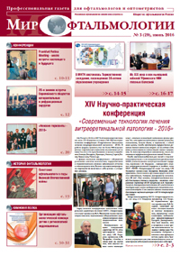
Russian Ophthalmology Society
”The World of Ophthalmology” is the official ROS newspaper Founded in 2011

Slide 13
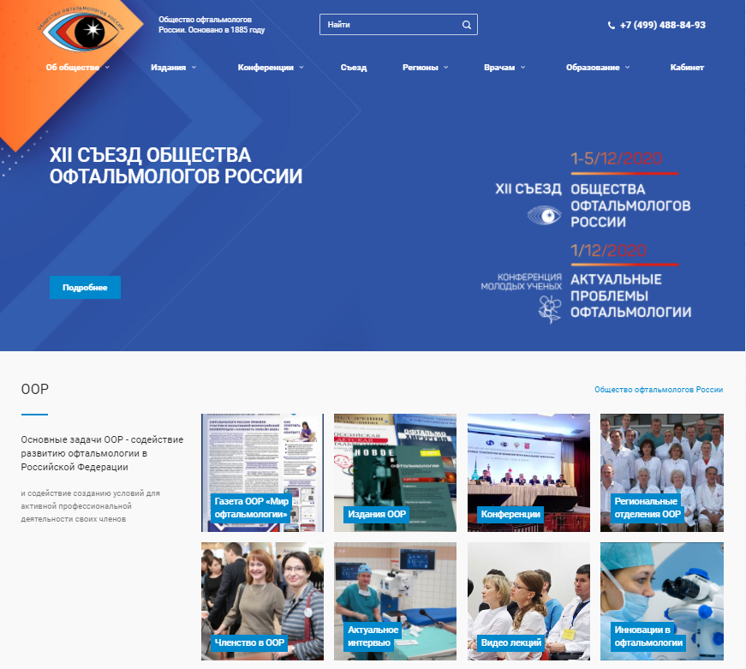
Russian Ophthalmology Society
ROS official webpage
www.oor.ru

